Slide 1

Thermodynamics and Combustion
Midterm presentation
202350529 Su Heon Ha
Energy & Material Circulation System Laboratory

Slide 2
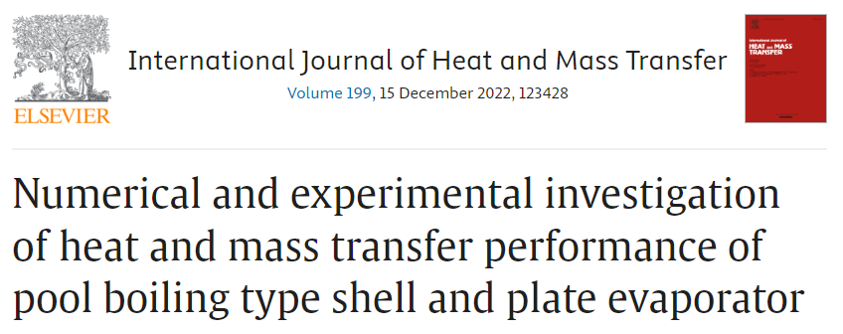
Energy & Material Circulation System Laboratory

Slide 3
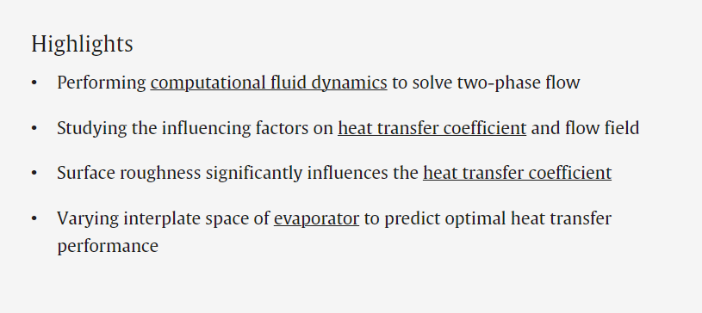
Energy & Material Circulation System Laboratory

Slide 4
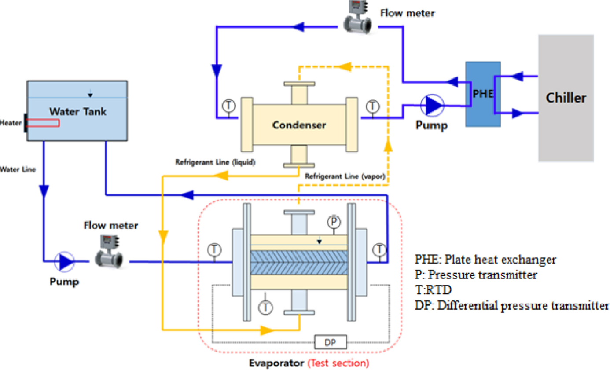
1. Experimental setup
Energy & Material Circulation System Laboratory

Slide 5
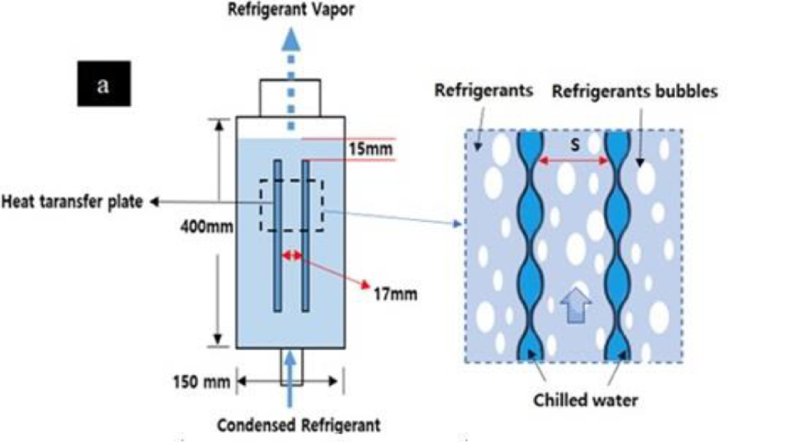
1.1 Cross-sectional view of the evaporator
Energy & Material Circulation System Laboratory

Slide 6
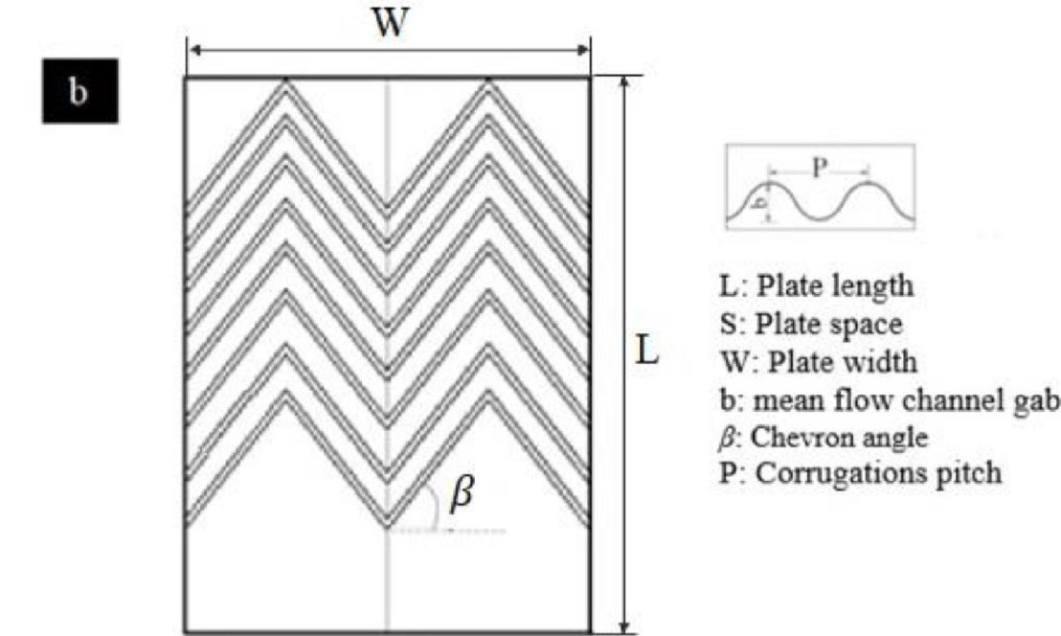
1.2 specification of the plate heat exchanger
Energy & Material Circulation System Laboratory

Slide 7
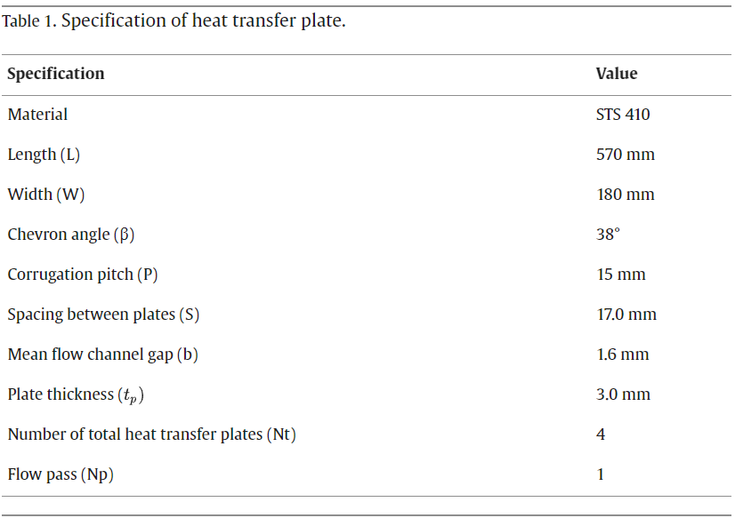
Energy & Material Circulation System Laboratory

Slide 8
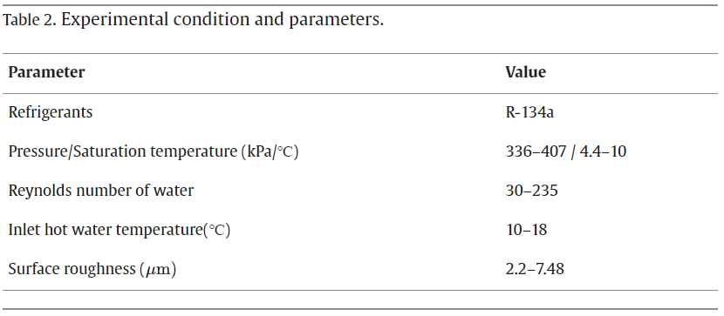
Energy & Material Circulation System Laboratory

Slide 9
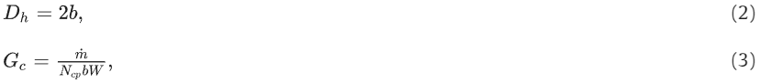
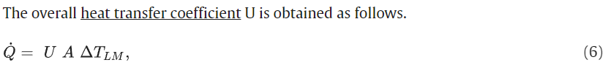
2.2 Data reduction
Energy & Material Circulation System Laboratory

Slide 10
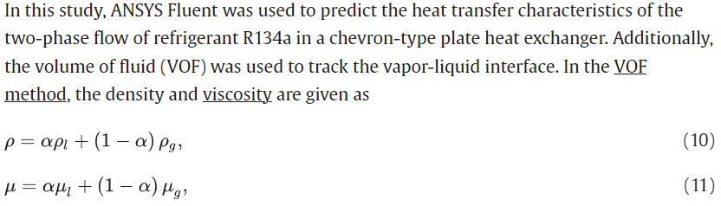
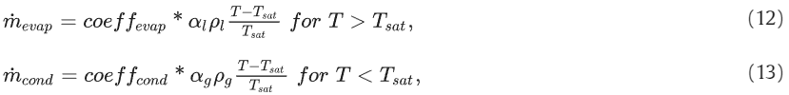
3.1 Mathematical model description
Energy & Material Circulation System Laboratory

Slide 11
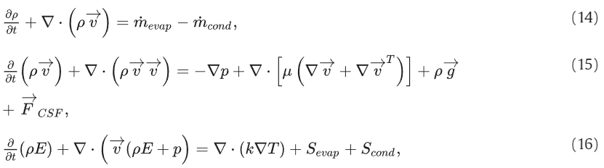
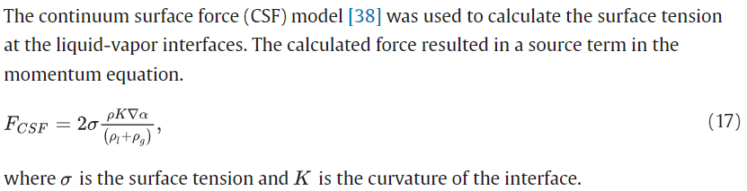
Energy & Material Circulation System Laboratory

Slide 12
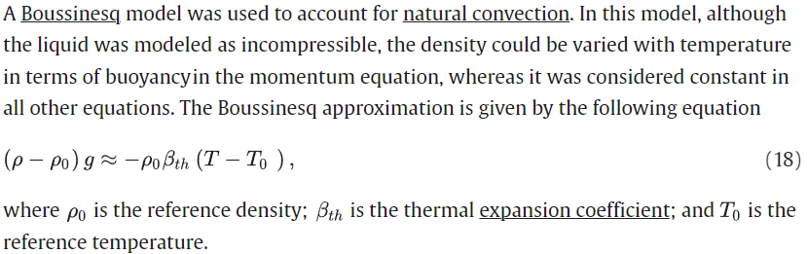
Energy & Material Circulation System Laboratory

Slide 13
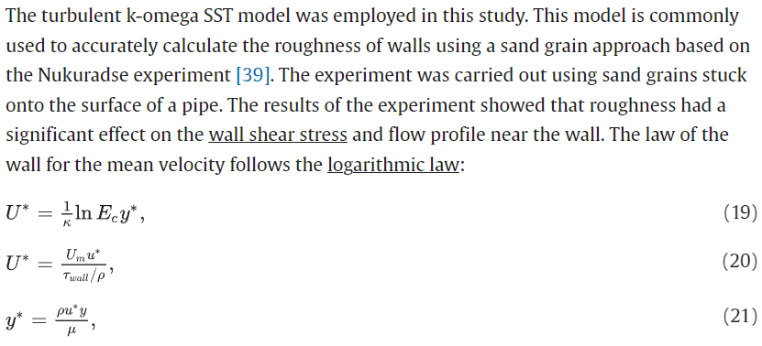
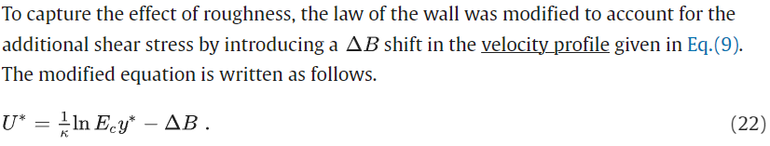
Energy & Material Circulation System Laboratory

Slide 14
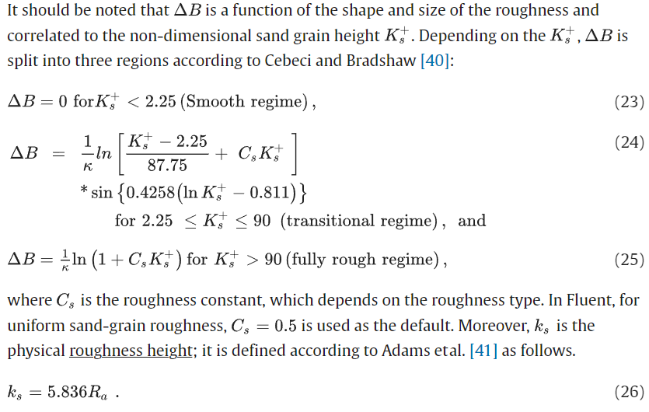
Energy & Material Circulation System Laboratory

Slide 15
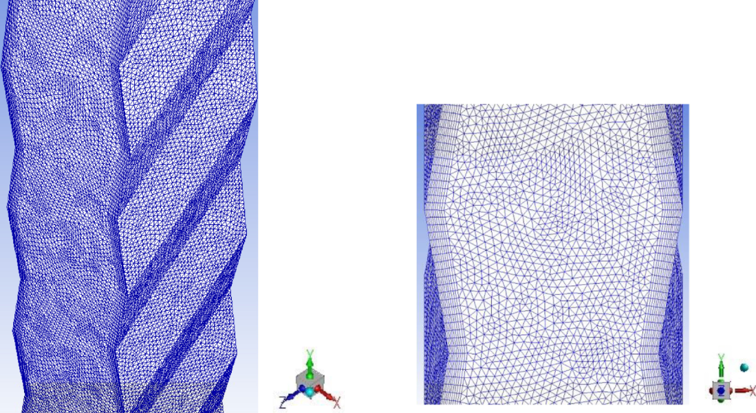
Energy & Material Circulation System Laboratory

Slide 16
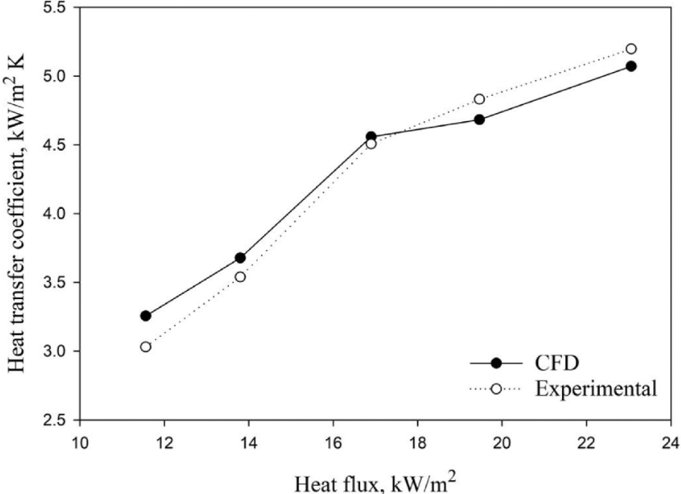
Energy & Material Circulation System Laboratory

Slide 17
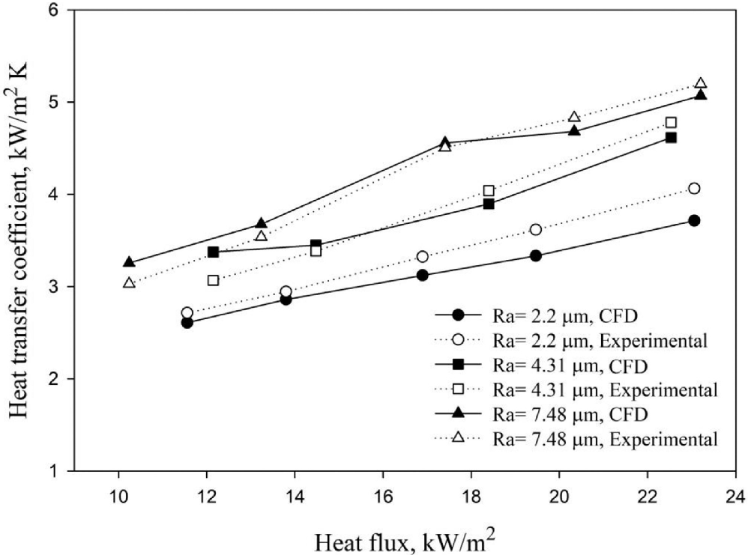
Energy & Material Circulation System Laboratory

Slide 18
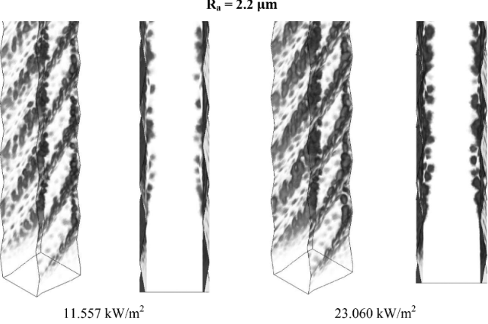
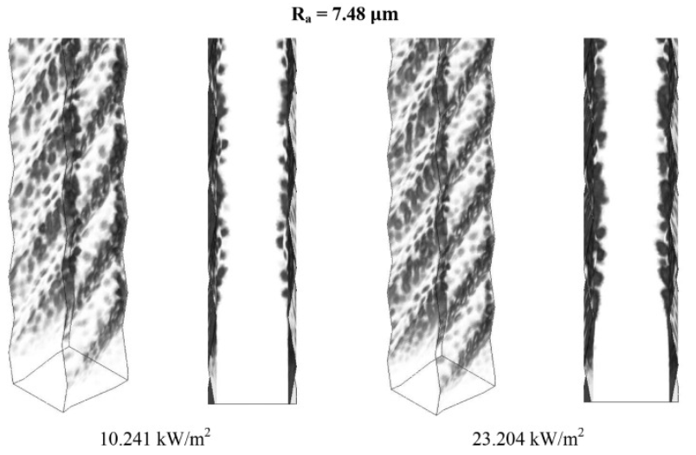
Energy & Material Circulation System Laboratory

Slide 19
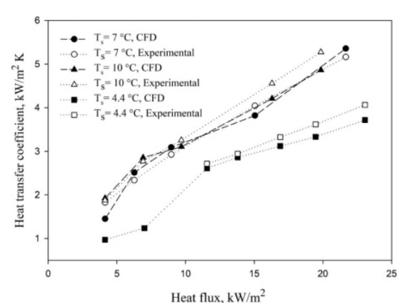
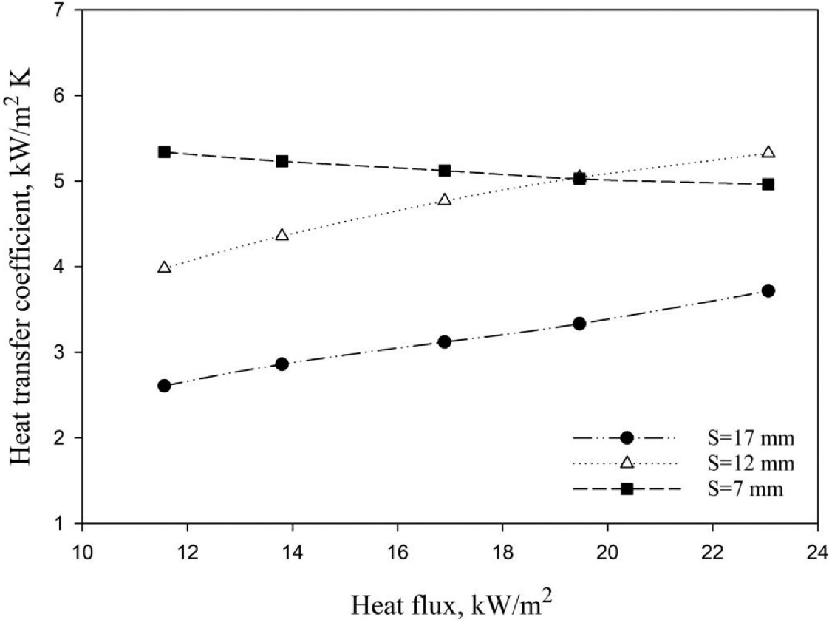
Energy & Material Circulation System Laboratory

Slide 20
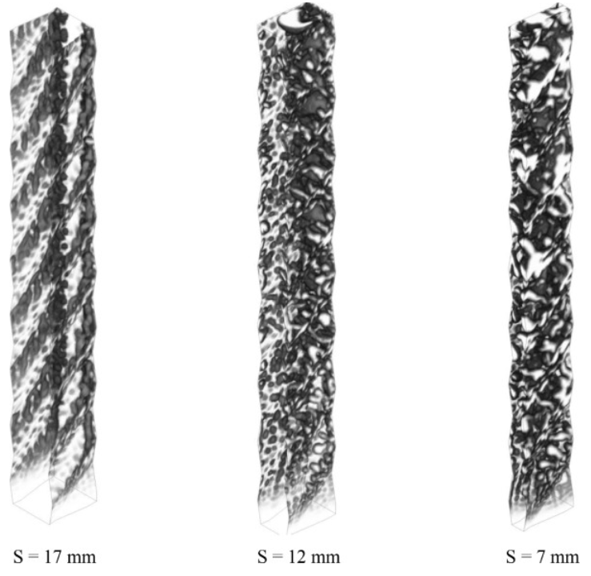
Energy & Material Circulation System Laboratory

Slide 21
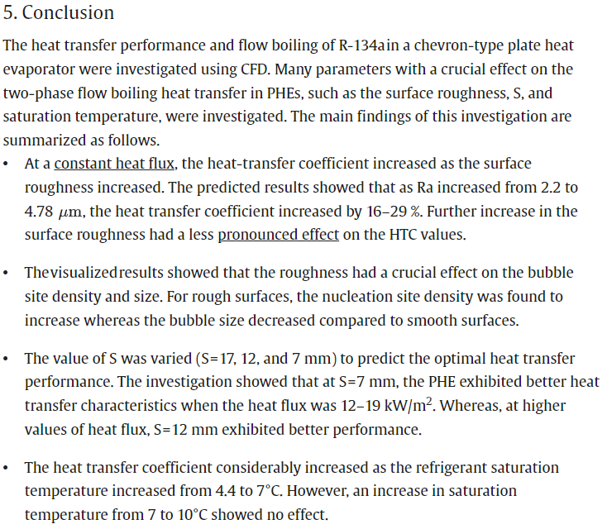
Energy & Material Circulation System Laboratory

